Slide 1
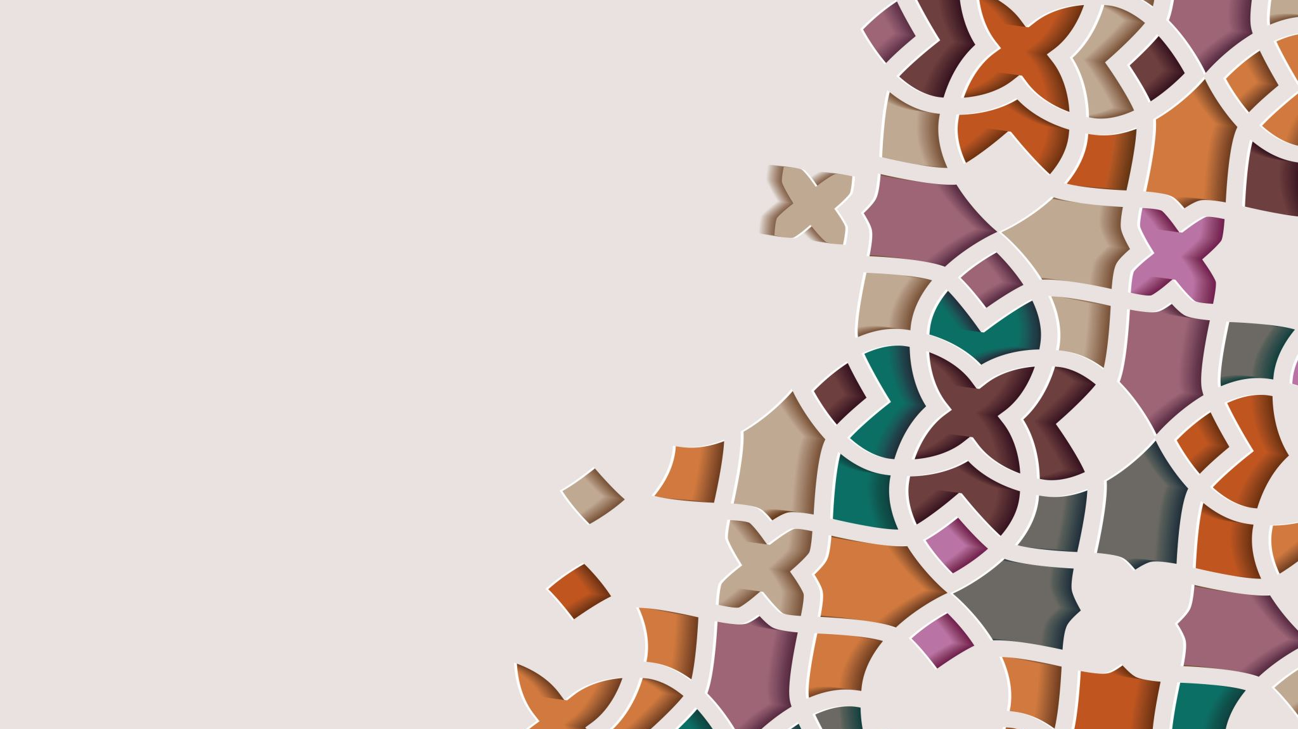
Capstone Project - The Battle of the Neighborhoods

Slide 2
The Real Estate Company
We want to create a location for our real estate company somewhere in Scarborough, so we want to get all the information possible to be as efficient as possible in locating.
Canada is a very prosperous country willing to receive people from all around the glove, and because of this it is always a great idea to be dynamically looking for the best place to move in to.
We, the company, aim to find the most populous neighborhoods using clusters so we strategically find the best location for our company.

Slide 3
Location Decision
We decided to analyize Scarborough for two reasons, we are very familiar with this dataset from previous weeks in the course, and because Scarborough is naturally a very diverse location, both religiously and culturally. These kinds of location are very popular for new immigrants to move in to.

Slide 4
Challenge
This project's puprose is to find the best neighborhoods in the city for the company to move in to, so it's more accessible to new customers looking to move to Scarborough. This is done using Wikipedia data on postal codes, so we then use the Foursquare API to find the coordinates in order to cluster the neighborhoods.

Slide 5
Foursquare api
We will be using the Foursquare API to find the coordinates (latitude, longitude) in order to cluster the neighborhoods, using the K-Means algorithm found in the Scikit Learn library.

Slide 6
Data Description
For this project, we will ne using the Scarborough dataset found in Wikipedia. We have previously used this dataset in prior weeks, so we are familiar with it.
Dataset: https://en.wikipedia.org/wiki/List_of_postal_codes_of_Canada:_M
We will use the Foursquare API in order to find the coordinates for the postal codes. This will also give us the information regarding venue names, locations and menus for local restaurants.
Foursquare is a social networking service available for common smartphones. The app's purpose is to help you discover and share information about businesses and attractions around you.
After finding the list of potential neighborhoods, we then connect to the Foursquare API to get the information about venues inside each and every neighborhood.

Slide 7
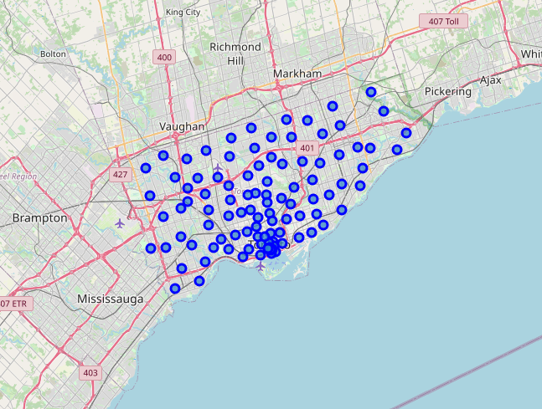
Analyzing the Data
We started preprocessing the data as we have done in previous weeks. We got the coordinates from Geocoder. We then used the Foursquare API to find the locations and venues in the city of Scarborough. This map shows the different postal codes in the city.

Slide 8
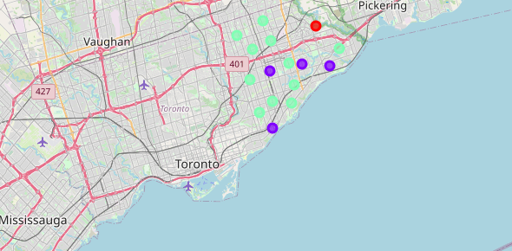
We then decided to cluster the neighborhoods in Scarborough to decide where we could use the new Real Estate location. We did this by using the K-Means clustering algorithm, with hyperparameter k = 3. This is the result:
As we can se the biggest clusters are the clusters == 2. These clusters have the highest rated venues, and are the closest to Scarboroughs three airports.
Following this, an economical analysis follows suit, but it falls out of the scopre of the project. After having these two, validated the project may continue.

Slide 9
conclusion
Using Data Science and data preprocessing we were able to map the different neighborhoods in Scarborough. Then, using the K-Means clustering algorithm, which is an unsupervised learning algorithm, we were able to find the neighborhood clusters in order to help us make the decission on where to place the new Real Estate location. This decission was also supported by the high rated venues, schools and nearby airports, as seen in the map above.

